Slide 1
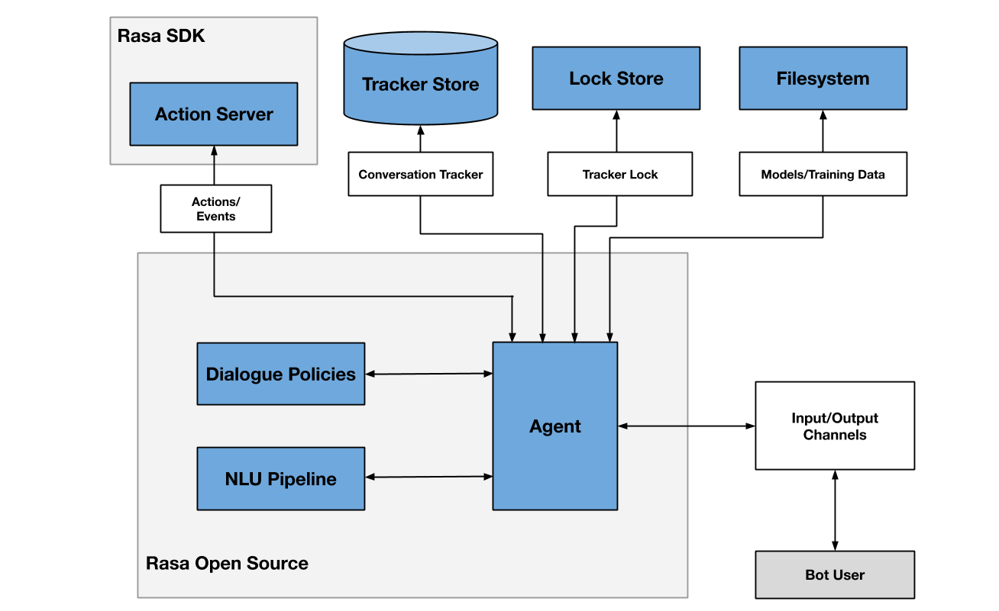
RASA
Rasa is an open-source machine learning framework for automated text and voice-based conversations. Understand messages, hold conversations, and connect to messaging channels and APIs.
Rasa Open Source has a scalable architecture.
The diagram below provides an overview of the Rasa Open-Source architecture. The two primary components are Natural Language Understanding (NLU) and dialogue management.

Slide 2
Rasa File Structure

Slide 3

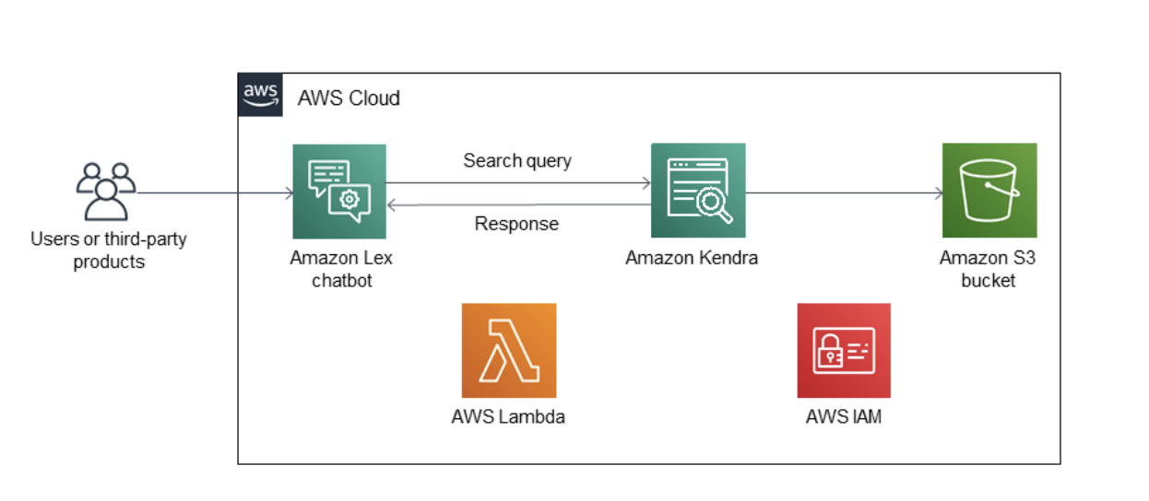
AWS Lex Chatbot
Amazon Kendra, a highly accurate and easy to use search service powered by machine learning, with Amazon Lex, a service for building engaging conversational experiences for voice and text.
An Amazon Lex chatbot with multiple intents for sending search queries to Amazon Kendra.
Created Amazon Kendra index for providing search results.
Using Amazon S3 bucket as the data source.

Slide 4
